Slide 1
Development of Secure Data Storage Drive MICRANTHROPE ADVANCED SYSTEMS & TECHNOLOGIES PRIVATE LIMITED Talking to ADRDE, Defence Research & Development Organization, Ministry Of Defence, GOI Establishment, Agra. By Deeksha kashyap 171500091

Slide 2
INTRODUCTION
USB storage devices (flash drives, USB sticks etc.) offer many advantages for us. However, at the same time, they cause security problems because it is easy to copy a lot of files to a tiny USB memory in a few seconds. We might have some secure data on our PC which we do not want show other users to copy through the USB. Therefore, we many need to define a USB storage policy to make USB drives write protected or not to be accessed through the another person.

Slide 3
Purpose
Secure data storage applies to data at rest stored in computer/server hard disks, portable devices – like external hard drives or USB drives – as well as online/cloud, network-based storage area network (SAN) or network attached storage (NAS) systems.
Secure data storage is achieved in the following ways:
Data encryption
Access control mechanism at each data storage device/software
Protection against viruses, worms and other data corruption threats
Physical/manned storage device and infrastructure security
Enforcement and implementation of layered/tiered storage security architecture

Slide 4
GENERAL MANAGEMENT
ISO 9001 is defined as the international standard that specifies requirements for a quality management system (QMS). Organizations use the standard to demonstrate the ability to consistently provide products and services that meet customer and regulatory requirements. It is the most popular standard in the ISO 9000 series and the only standard in the series to which organizations can certify.
Six Sigma is a set of management tools and techniques designed to improve business by reducing the likelihood of error. It is a data-driven approach which uses statistical methodology for eliminating defects.

Slide 5
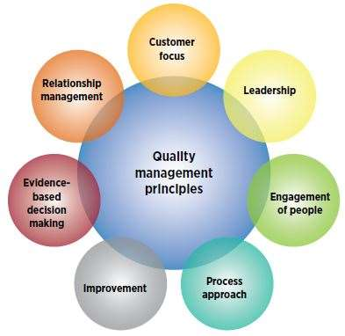

Slide 6
SEI CMM
SEI refers to Software Engineering Institute of Carnegie Mellon University in Pittsburgh, it helps to improve software development process. SEI offers technical guidance for advanced practice in software engineering.
CMM refers to ‘Capability Maturity Model’, presently called as CMMI ‘Capability Maturity Model Integration’; it was developed by SEI and used to understand the processes followed in as organization. CMMI ratings were given to organizations after review by auditors.

Slide 7
Software Engineering Model
Extreme Programming (XP) is an agile software development framework that aims to produce higher quality software, and higher quality of life for the development team. XP is the most specific of the agile frameworks regarding appropriate engineering practices for software development.
Adaptive Software Development (ASD) is a direct outgrowth of an earlier agile framework, Rapid Application Development (RAD). It aims to enable teams to quickly and effectively adapt to changing requirements or market needs by evolving their products with lightweight planning and continuous learning. The ASD approach encourages teams to develop according to a three-phase process: speculate, collaborate, and learn
The Dynamic Systems Development technique (DSDM) is an associate degree agile code development approach that provides a framework for building and maintaining systems. The DSDM philosophy is borrowed from a modified version of the sociologist principle—80 % of an application is often delivered in twenty percent of the time it’d desire deliver the entire (100 percent) application

Slide 8
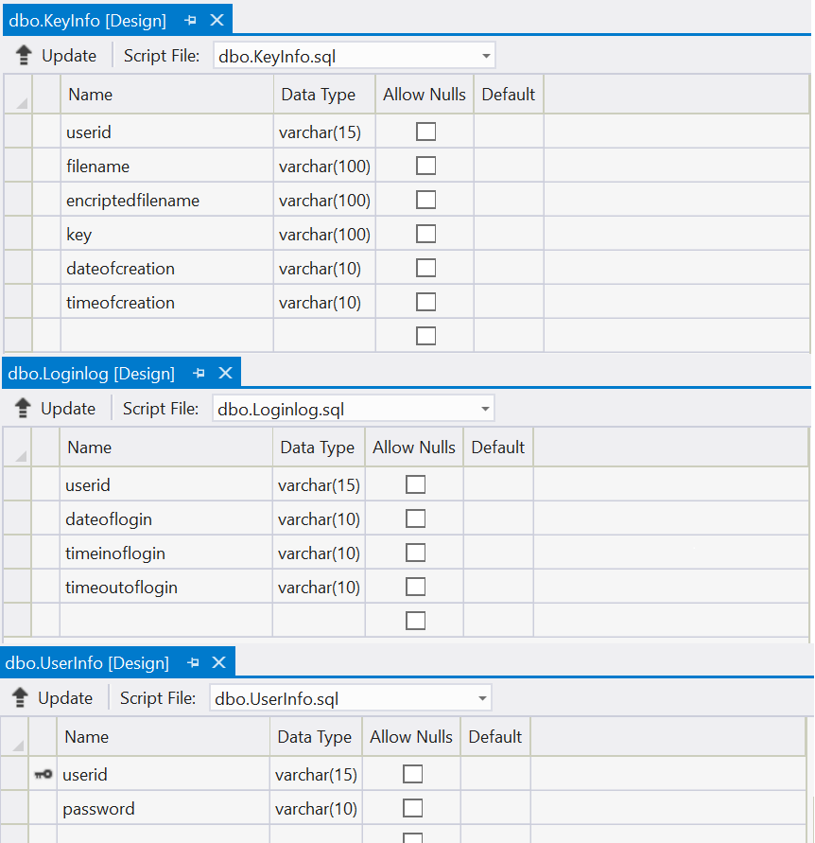
DATABASE TABLES

Slide 9
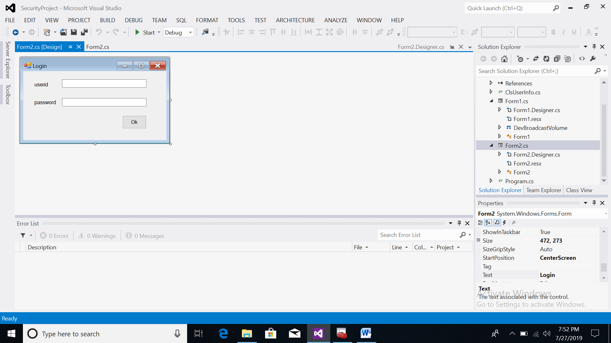
FORM2.DESIGN.CS

Slide 10
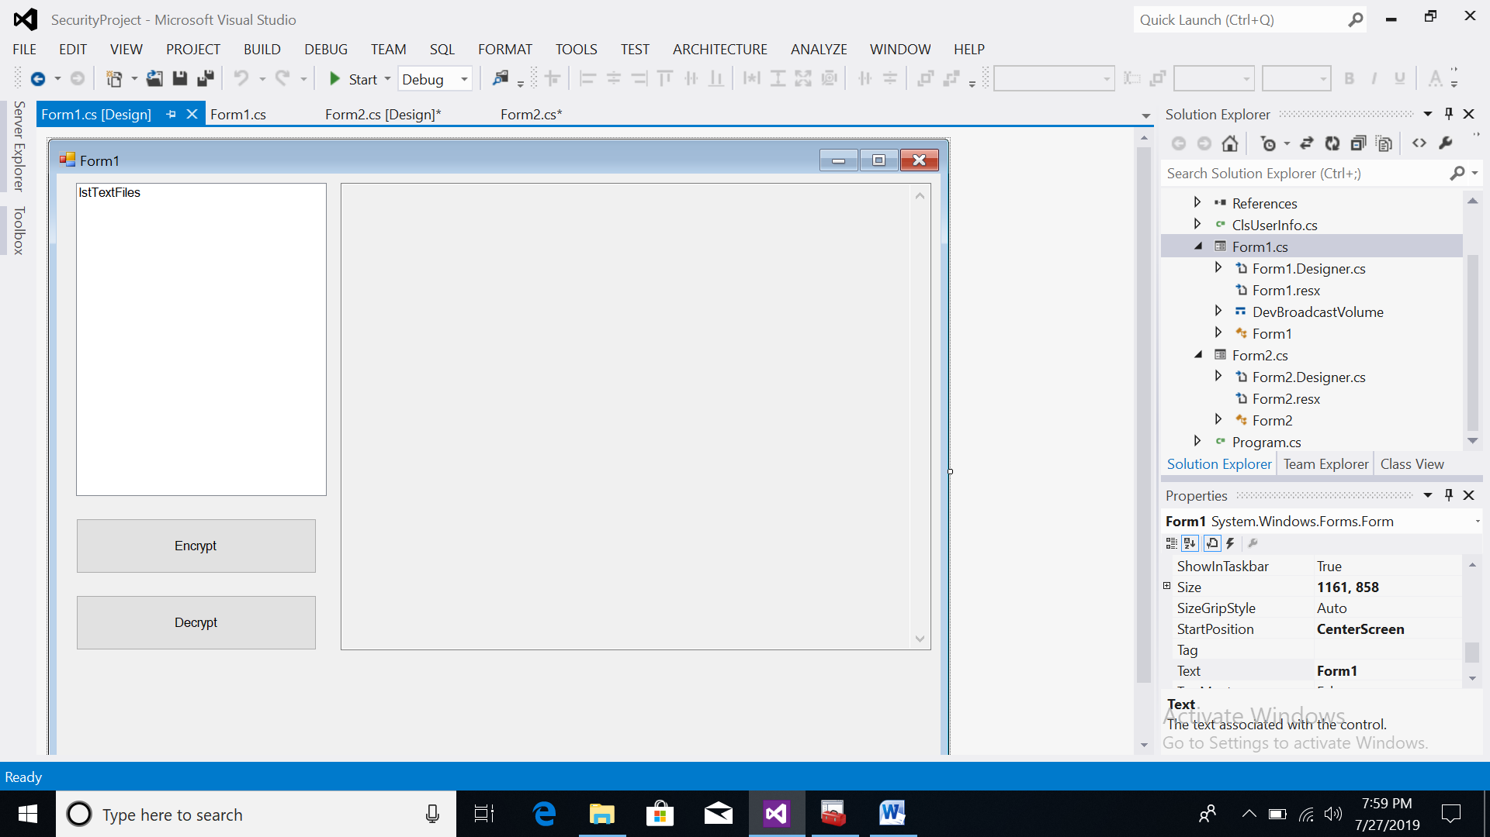
FORM1.DESIGN.CS

Slide 11
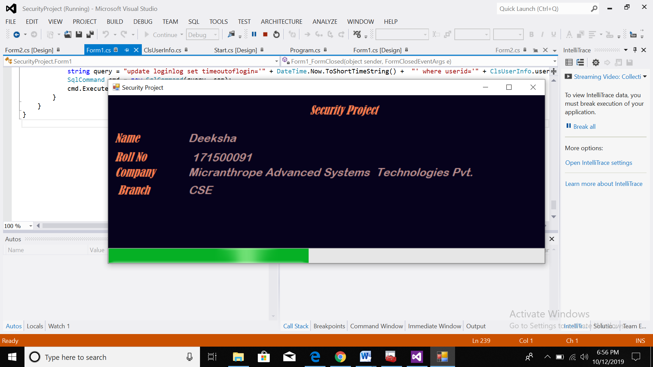
RUN THE PROJECT

Slide 12
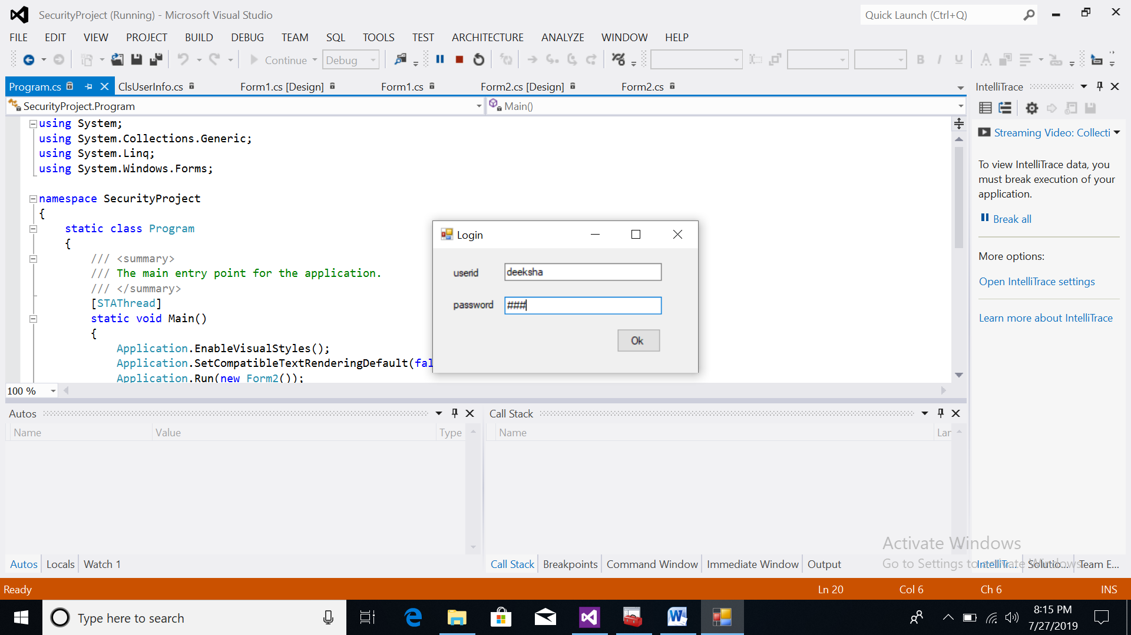

Slide 13
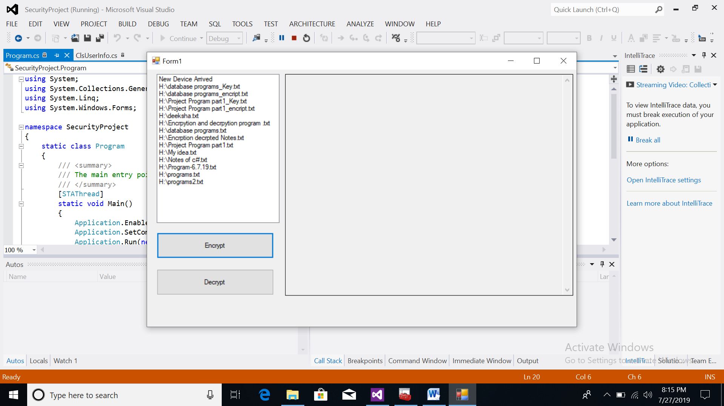
PEN DRIVE INSERT

Slide 14
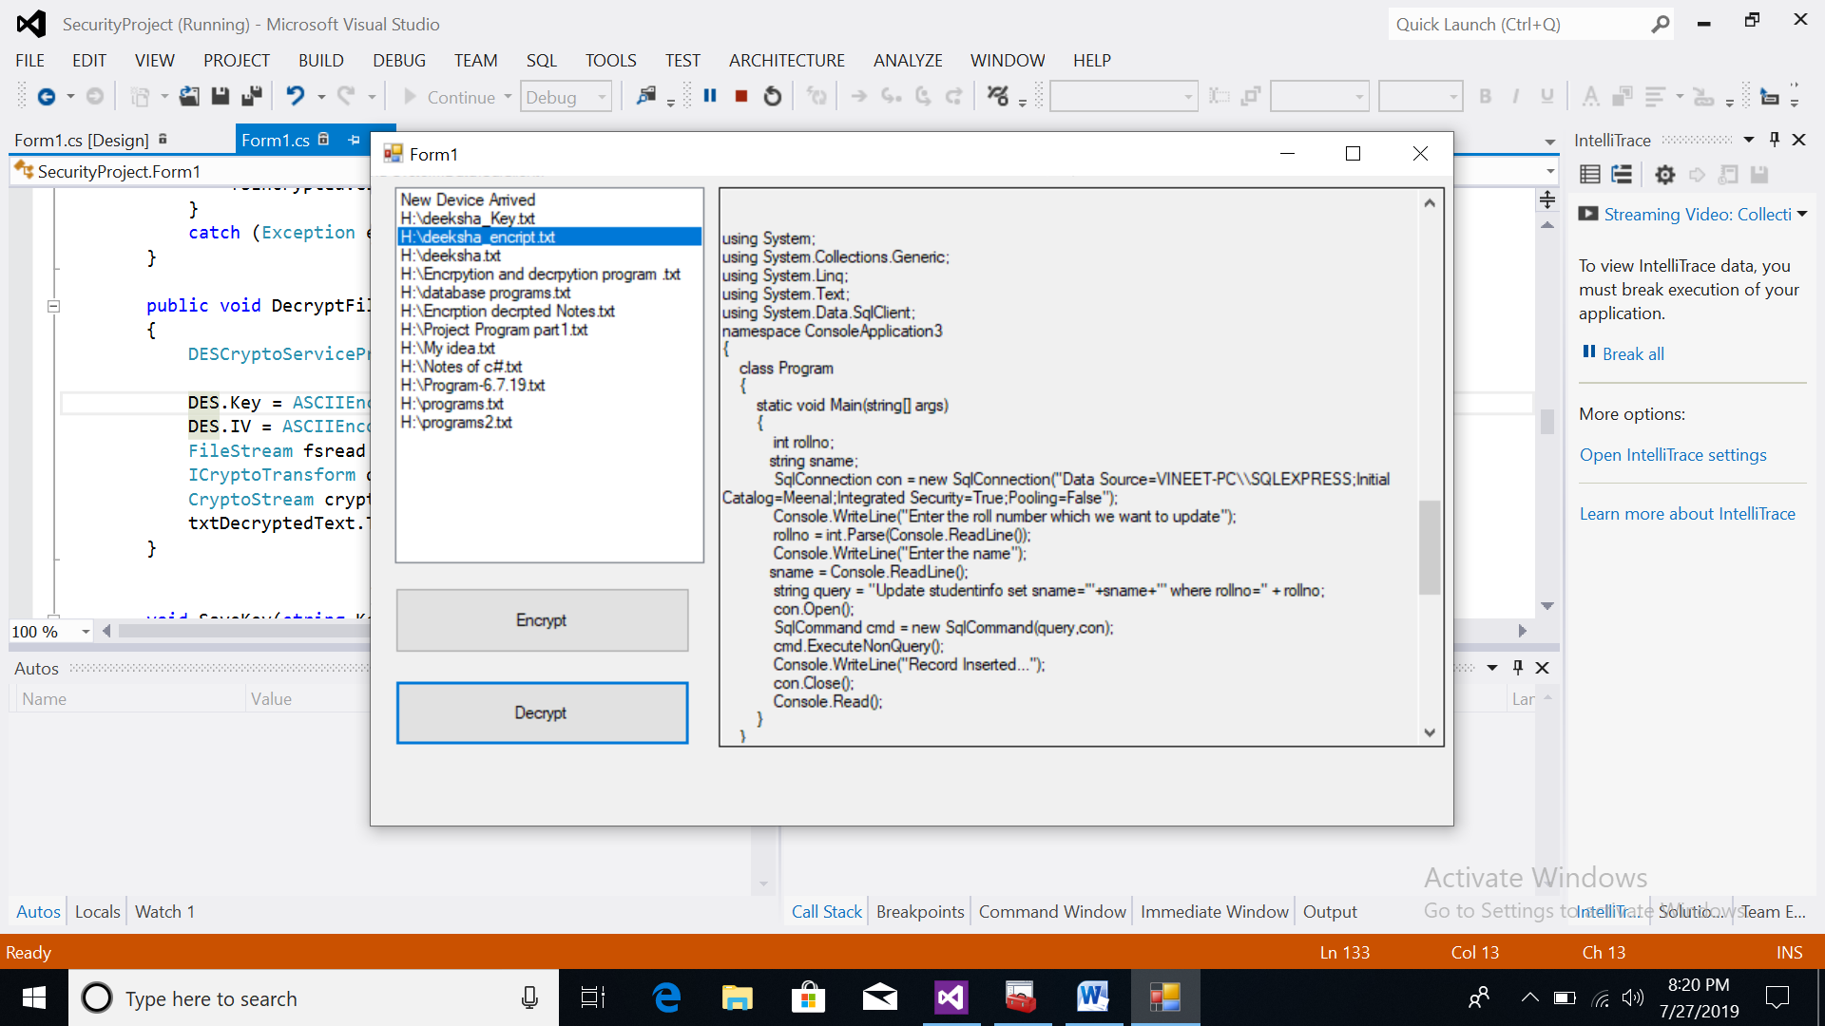
DECRYPED FILE

Slide 15
Thank You

